Slide 1
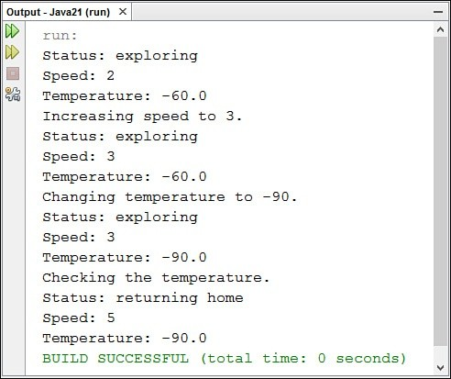
After you have compiled the application, run the program by choosing the menu command Run, Run File. The output displayed by the MarsApplication class appears in an Output pane in NetBeans, as shown in Figure 1.1.
FIGURE 1.1 The output of the MarsApplication class.
Using Listing 1.2 as a guide, you can see the following things taking place in the main()
class method of this application:
Line 2—The main() method is created and named. All main() methods take this format, as you’ll see later. ” For now,
the most important thing to note is the static keyword, which indicates that the
method is a class method shared by all MarsRobot objects.
Line 3—A new MarsRobot object is created using the class as a template. The object is given the name spirit.
Lines 4–6—Three instance variables of the spirit object are given values: status is set to the text “exploring,” speed is set to 2, and temperature is set to –60.
Line 8—On this line and several that follow, the showAttributes() method of the spirit object is called. This method displays the current values of the instance variables status, speed, and temperature.

Slide 2
Line 9—On this line and others that follow, a call to the System.out.println() method displays the text within parentheses to the output device (your monitor).
Line 10—The speed instance variable is set to the value 3.
Line 13—The temperature instance variable is set to the value –90.
Line 16—The checkTemperature() method of the spirit object is called. This method checks to see whether the temperature instance variable is less than
–80. If it is, status and speed are assigned new values.
Organizing Classes and Class Behavior
Object-oriented programming in Java also requires three more concepts: inheritance, interfaces, and packages. All three are mechanisms for organizing classes and class behavior.
Inheritance
Inheritance, one of the most crucial concepts in object-oriented programming, has a direct impact on how you design and write your own Java classes.
Inheritance is a mechanism that enables one class to inherit the behavior and attributes of another class.
Through inheritance, a class automatically picks up the functionality of an existing class. The new class must only define how it is different from that existing class.
With inheritance, all classes—including those you create and the ones in the Java Class Library—are arranged in a strict hierarchy.
A class that inherits from another class is called a subclass. The class that gives the inheritance is called a superclass.
A class can have only one superclass, but it can have an unlimited number of subclasses. Subclasses inherit all the attributes and behavior of their superclass.
In practical terms, this means that if the superclass has behavior and attributes that your class needs, you don’t have to redefine the behavior or copy that code to have the same behavior and attributes. Your class automatically receives these things from its superclass, the superclass gets them from its superclass, and so on, all the way up the hierarchy. Your class becomes a combination of its own features and all the features of the classes above it in the hierarchy.

Slide 3
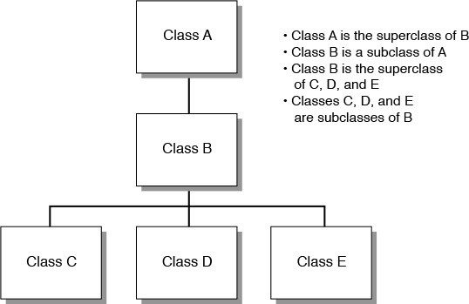
The situation is comparable to how you inherited traits from your parents, such as your height, hair color, and love of peanut-butter-and-banana sandwiches. They inherited some of these things from their parents, who inherited from theirs, and backward through time to the Garden of Eden, Big Bang, giant spaghetti monster, or [insert personal belief here].
Figure 1.2 shows how a hierarchy of classes is arranged.
FIGURE 1.2 A class hierarchy.
At the top of the Java class hierarchy is the class Object.
All classes inherit from this superclass. Object is the most general class in the hierarchy. It defines behavior inherited by all the classes in the Java Class Library.
Each class further down the hierarchy becomes more tailored to a specific purpose. A class hierarchy defines abstract concepts at the top of the hierarchy. Those concepts become more concrete further down the line of subclasses.
Often when you create a new class in Java, you want all the functionality of an existing class except for some additions or modifications of your own creation. For example, you might want a new version of CommandButton that makes a sound when clicked.
To receive all the CommandButton functionality without doing any work to re-create it, you can define your new class as a subclass of CommandButton.
Because of inheritance, your class automatically inherits behavior and attributes defined in CommandButton as well as the behavior and attributes defined in the superclasses of CommandButton. All you have to worry about are the things that make your new class different from CommandButton itself. Subclassing is the mechanism for defining new classes as the differences between those classes and their superclass.
Subclassing is the creation of a new class that inherits from an existing class. The only task in the subclass is to indicate the differences in behavior and attributes between the subclass and its superclass.

Slide 4
If your class defines entirely new behavior and isn’t a subclass of another class, you can inherit directly from the Object class.
If you create a class that doesn’t indicate a superclass, Java assumes that the new class inherits directly from Object. The MarsRobot class you created earlier today did not specify a superclass, so it’s a subclass of Object.
Creating a Class Hierarchy
If you’re creating a large set of classes, it makes sense for your classes to inherit from the existing class hierarchy and to make up a hierarchy themselves. This gives your classes several advantages:
Functionality common to multiple classes can be put into a superclass, which enables it to be used repeatedly in all classes below it in the hierarchy.
Changes to a superclass automatically are reflected in all its subclasses, their subclasses, and so on. There is no need to change or recompile any of the lower classes; they receive the new information through inheritance.
For example, imagine that you have created a Java class to implement all the features of an exploratory robot. (This shouldn’t take much imagination.)
The MarsRobot class is completed and works successfully. Your boss at NASA asks you to create a Java class called MercuryRobot.
These two kinds of robots have similar features. Both are research robots that work in hostile environments and conduct research. Both keep track of their current temperature and speed.
Your first impulse might be to open the MarsRobot.java source file, copy it into a new source file called MercuryRobot.java, and then make the necessary changes for the new robot to do its job.
A better plan is to figure out the common functionality of MercuryRobot and MarsRobot and organize it into a more general class hierarchy. This might be a lot of work just for the classes MarsRobot and MercuryRobot, but what if you also want to add MoonRobot, UnderseaRobot, and DesertRobot? Factoring common behavior into one or more reusable superclasses significantly reduces the overall amount of work you must do.
To design a class hierarchy that might serve this purpose, start at the top with the class
Object, the pinnacle of all Java classes.
The most general class to which these robots belong might be called Robot. A robot, generally, could be defined as a self-controlled exploration device. In the Robot class, you define only the behavior that qualifies something to be a device, to be self-controlled, and to be designed for exploration.
There could be two classes below Robot: WalkingRobot and DrivingRobot. The obvious thing that differentiates these classes is that one travels by foot and the other by wheel. The behavior of walking robots might include bending over to pick up something,

Slide 5
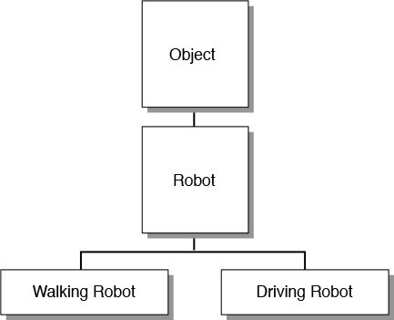
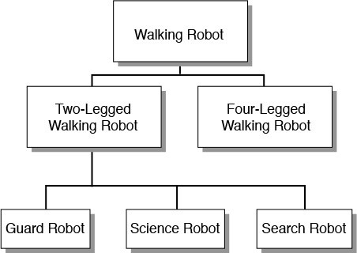
ducking, running, and the like. Driving robots would behave differently. Figure 1.3 shows what you have so far.
FIGURE 1.3 The basic Robot hierarchy.
Now, the hierarchy can become even more specific.
With WalkingRobot, you might have several classes: ScienceRobot, GuardRobot, SearchRobot, and so on. As an alternative, you could factor out still more functionality and have intermediate classes for TwoLegged and FourLegged robots, with different behaviors for each (see Figure 1.4).
FIGURE 1.4 Two-legged and four-legged walking robots.
Finally, the hierarchy is done, and you have a place for MarsRobot. It can be a subclass of ScienceRobot, which is a subclass of WalkingRobot, which is a subclass of Robot, which is a subclass of Object.
Where do attributes such as status, temperature, and speed come in? At the place they fit

Slide 6
into the class hierarchy most naturally. Because all robots need to keep track of the temperature of their environment, it makes sense to define temperature as an instance variable in Robot. All subclasses would have that instance variable as well. Remember that you need to define a behavior or attribute only once in the hierarchy, and it is inherited automatically by each subclass.
Note
Designing an effective class hierarchy involves a lot of planning and revision. As you attempt to put attributes and behavior into a hierarchy, you’re likely to find reasons to move some classes to different spots in the hierarchy. The goal is to reduce the number of repetitive features (and redundant code) needed.
Inheritance in Action
Inheritance in Java works much more simply than it does in the real world. No wills or courts are required when inheriting from a parent.
When you create a new object, Java keeps track of each variable defined for that object and each variable defined for each superclass of the object. In this way, all the classes combine to form a template for the current object, and each object fills in the information appropriate to its situation.
Methods operate similarly. A new object has access to all method names of its class and superclass. This is determined dynamically when a method is used in a running program. If you call a method of a particular object, the Java virtual machine first checks the object’s class for that method. If the method isn’t found, the virtual machine looks for it in the superclass of that class, and so on, until the method definition is found. This is illustrated in Figure 1.5.

Slide 7
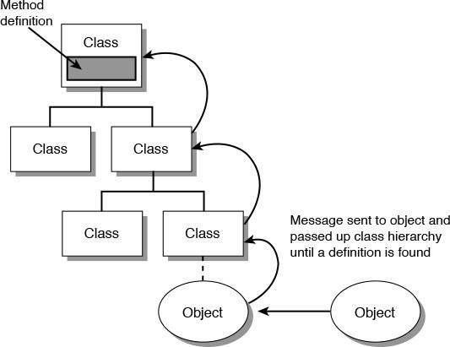
FIGURE 1.5 How methods are located in a class hierarchy.
Things get complicated when a subclass defines a method that matches a method defined in a superclass in name and other aspects. In this case, the method definition found first (starting at the bottom of the hierarchy and working upward) is the one that is used.
Because of this, you can create a method in a subclass that prevents a method in a superclass from being used. To do this, you give the method the same name, return type, and arguments as the method in the superclass. This procedure, shown in Figure 1.6, is called overriding.

Slide 8
Inheritance example
extends is the keyword used to inherit the properties of a class. Following is the syntax of extend
Syntax
class Super {
.....
.....
}
class Sub extends Super {
.....
.....
}
class Calculation { int z;
public void addition(int x, int y) { z = x + y;
System.out.println("The sum of the given numbers:"+z);
}
public void Subtraction(int x, int y) { z = x - y;
System.out.println("The difference between the given numbers:"+z);
}
}
public class My_Calculation extends Calculation { public void multiplication(int x, int y) {
z = x * y;
System.out.println("The product of the given numbers:"+z);
}
public static void main(String args[]) { int a = 20, b = 10;
My_Calculation demo = new My_Calculation(); demo.addition(a, b);
demo.Subtraction(a, b);
demo.multiplication(a, b);
}
}

Slide 9
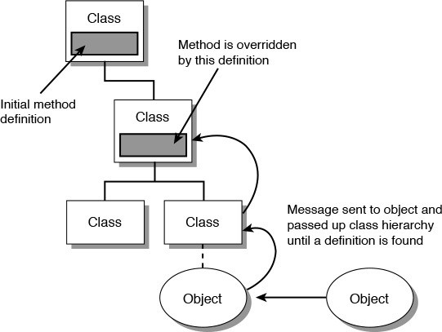
FIGURE 1.6 Overriding methods.
Note
Java’s form of inheritance is called single inheritance because each Java class can have only one superclass, although any given superclass can have multiple subclasses.
In other object-oriented programming languages such as C++, classes can have more than one superclass, and they inherit combined variables and methods from all those superclasses. This is called multiple inheritance. Java makes inheritance simpler by allowing only single inheritance.
Interfaces
Single inheritance makes the relationship between classes and the functionality they implement easier to understand and design. However, it also can be restrictive, especially when you have similar behavior that needs to be duplicated across different branches of a class hierarchy. Java solves the problem of shared behavior by using interfaces.
An interface is a collection of methods that indicate a class has some behavior in addition to what it inherits from its superclasses. The methods included in an interface do not define this behavior; that task is left for the classes that implement the interface.
For example, the Comparable interface contains a method that compares two objects of the same class to see which one should appear first in a sorted list. Any class that implements this interface shows other objects that it knows how to determine the sorting order for objects of that class. This behavior would be unavailable to the class without the interface.
You’ll learn more about interfaces in the next lectures.

Slide 10
Packages
Packages in Java are a way to group related classes and interfaces. Packages enable groups of classes to be referenced more easily in other classes. They also eliminate potential naming conflicts among classes.
Classes in Java can be referred to by a short name such as Object or a full name such as
java.lang.Object.
By default, your Java classes can refer to the classes in the java.lang package using only short names. The java.lang package provides basic language features such as string handling and mathematical operations. To use classes from any other package, you must refer to them explicitly using their full package name or use an import command to import the package in your source code file.
Because the Color class is contained in the java.awt package, you normally refer to it in your programs with the notation java.awt.Color.
If the entire java.awt package has been imported using import, the class can be referred to as Color.
The package for a class is determined by the package statement. Many of the classes you create in this book are put in the com.java24hours package, like so:
package com.java24hours;
This statement must be the first line of the program. When it is omitted, as it was in the MarsRobot and MarsApplication programs you created today, the class belongs to an unnamed package called the default package.
Summary
If today was your first exposure to object-oriented programming, it probably seemed theoretical and a bit overwhelming.
Because your brain has been stuffed with object-oriented programming concepts and terminology for the first time, you might be worried that no room is left for the remaining java lessons.
Don’t panic. Keep calm and carry on.
At this point, you should have a basic understanding of classes, objects, attributes, and behavior. You also should be familiar with instance variables and methods. You’ll use these right away in the next lecture.
The other aspects of object-oriented programming, such as inheritance and packages, will be covered in more detail in upcoming days.
You’ll work with object-oriented programming in every remaining lectures. There’s no other way to create programs in Java.
By the time you finish the first lectures, you’ll have working experience with objects,
Page 22 of 24

Slide 11
classes, inheritance, and all other aspects of the methodology.
Q&A
Q Methods are functions defined inside classes. If they look like functions and act like functions, why aren’t they called functions?
A Some object-oriented programming languages do call them functions. (C++ calls them member functions.) Other object-oriented languages differentiate between functions inside and outside the body of a class or object because in those languages the use of the separate terms is important to understanding how each function works. Because the difference is relevant in other languages and because the term method now is in common use in object-oriented terminology, Java uses the term as well.
Q What’s the distinction between instance variables and methods and their counterparts, class variables and methods?
A Almost everything you do in a Java program involves instances (also called objects) rather than classes. However, some behavior and attributes make more sense if stored in the class itself rather than in the object.
For example, the Math class in the java.lang package includes a class variable called PI that holds the approximate value of pi. This value does not change, so there’s no reason why different objects of that class would need their own individual copy of the PI variable. On the other hand, every String object contains a method called length() that reveals the number of characters in that String. This value can be different for each object of that class, so it must be an instance method.
Class variables occupy memory until a Java program is finished running, so they should be used with care. If a class variable references an object, that object will remain in memory as well. This is a common problem causing a program to take up too much memory and run slowly.
Q When a Java class imports an entire package, does it increase the compiled size of that class?
A No. The use of the term “import” is a bit misleading. The import keyword does not add the bytecode of one class or one package to the class you are creating.
Instead, it makes it easier to refer to classes within another class.
The sole purpose of importing is to shorten the class names when they’re used in Java statements. It would be cumbersome to always have to refer to full class names such as javax.swing.JButton and java.awt.Graphics in your code instead of calling them JButton and Graphics.
Quiz
Review today’s material by taking this three-question quiz.
Questions
1. What is another word for a class?

Slide 12
Object
Template
Instance
When you create a subclass, what must you define about that class?
Nothing. Everything is defined already.
Things that are different from its superclass
Everything about the class
What does an instance method of a class represent?
The attributes of that class
The behavior of that class
The behavior of an object created from that class
Answer it the following questions without looking at today’s material. Which of the following statements is true?
All objects created from the same class must be identical.
All objects created from the same class can have different attributes than each other.
An object inherits attributes and behavior from the class used to create it.
A class inherits attributes and behavior from its subclass.
Exercises
To extend your knowledge of the subjects covered today, try the following exercises:
1. In the main() method of the MarsRobot class, create a second MarsRobot
robot named opportunity, set up its instance variables, and display them.

